Slide 1
Generative Models II – Generative Adversarial Networks (GANs)
Exploring Theory, Variants, and Applications

Slide 2
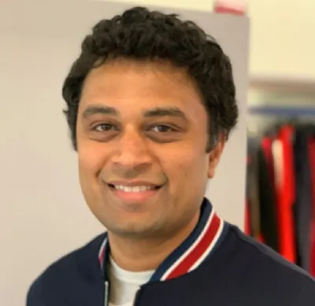
Harish Kashyap: harish@pandita.ai
An Entrepreneur and AI SME at MIT, Boston in machine learning, robotics, big data, Gen AI and signal processing.
Over a decade of experience as a researcher across various industries, including Amazon Robotics, KLA Tencor and BBN Technologies.
Career highlights include leading the development of AI-driven algorithms that interact with robotic systems.
Founder of two companies, Mysuru Consulting Group(MCG) and Pandita AI.
GitHub: https://github.com/harishkashyap
LinkedIn: https://www.linkedin.com/in/hkashyap/

Slide 3
Introduction to GANs
GANs are a class of generative models introduced by Ian Goodfellow in 2014.
Comprise two neural networks:
  Generator: Creates synthetic data resembling real data.
  Discriminator: Distinguishes between real and synthetic data.
Aim: Generator learns to produce data that fools the discriminator.
Applications: Image generation, data augmentation, style transfer, and more.

Slide 4
Variants of GANs
Conditional GANs (CGANs)
Extend GANs by conditioning on auxiliary information (e.g., class labels).
Objective:
Applications: Class-specific image generation, text-to-image synthesis.
CycleGANs
Enable image-to-image translation without paired examples.
Key idea: Cycle consistency loss ensures transformations are reversible.
Applications: Style transfer, domain adaptation.
StyleGANs
Focus on controllable and high-quality image generation.
Introduce style-based architecture for fine-grained control over generated images.
Applications: Face generation, artistic content creation.

Slide 5
Notebook: Training a Conditional GAN (CGAN) on FashionMNIST
Key Concepts
Generator-Discriminator Interplay: The generator learns to create class-conditioned images while the discriminator differentiates real vs. fake for each class.
Class Conditioning:
  Input: Noise vector and class label .
  Output: Synthetic image corresponding to class .
Implementation
Dataset: FashionMNIST.
Framework: PyTorch or TensorFlow.
Steps:
  Prepare FashionMNIST dataset with class labels.
  Design generator and discriminator with class conditioning.
  Train using alternating updates for discriminator and generator.

Slide 6
Demo (Streamlit): StyleGAN Image Generator
Overview
Objective: Allow users to generate and tweak images using a pre-trained StyleGAN model.
Key Features:
  Input: Random seed and adjustable style parameters.
  Output: Generated images with user-specified styles.
  Real-time interactivity with sliders to modify attributes.
Implementation Details
Framework: Streamlit for UI.
Pre-trained Model: StyleGAN2 or StyleGAN3.
Steps:
  Load pre-trained StyleGAN model.
  Create Streamlit UI with input sliders for style parameters.
  Generate and display images in real time.

Slide 7
Summary and Applications
Summary
GANs are powerful generative models with wide-ranging applications.
Key concepts include adversarial training and generator-discriminator interplay.
Variants like CGANs, CycleGANs, and StyleGANs expand GAN capabilities.
Applications
Image generation (e.g., faces, fashion, art).
Domain adaptation and style transfer.
Data augmentation for machine learning models.
Video and 3D content creation.

